Slide 1
SMARTHORN USAGE
FOR DRIVERS

Slide 2
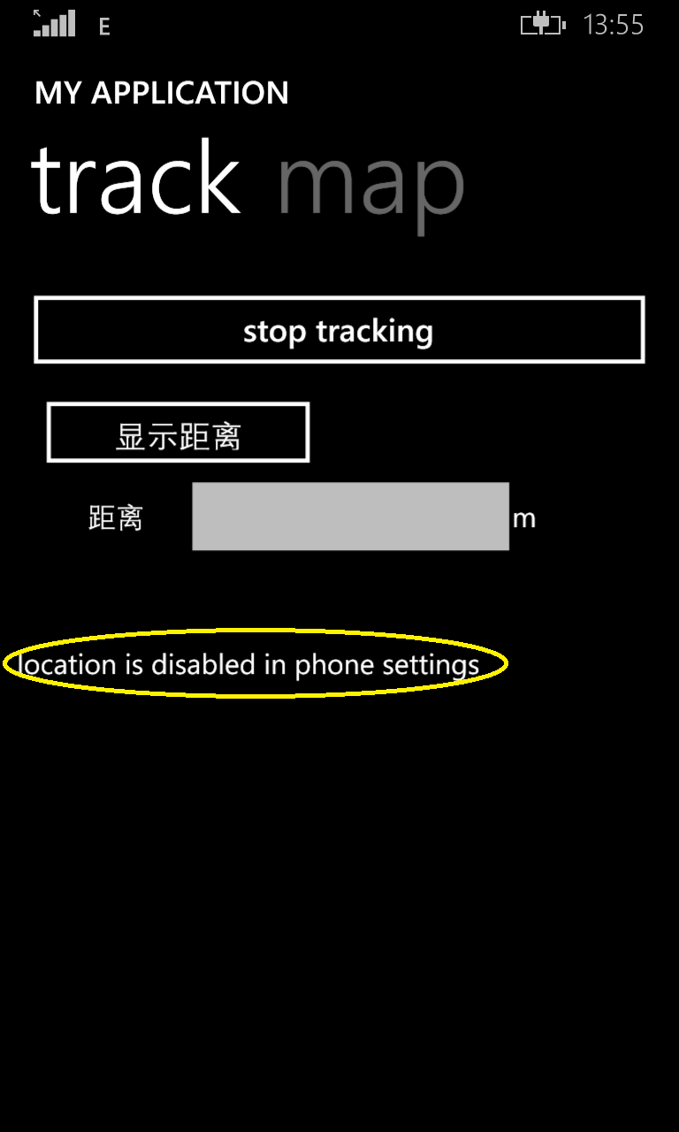
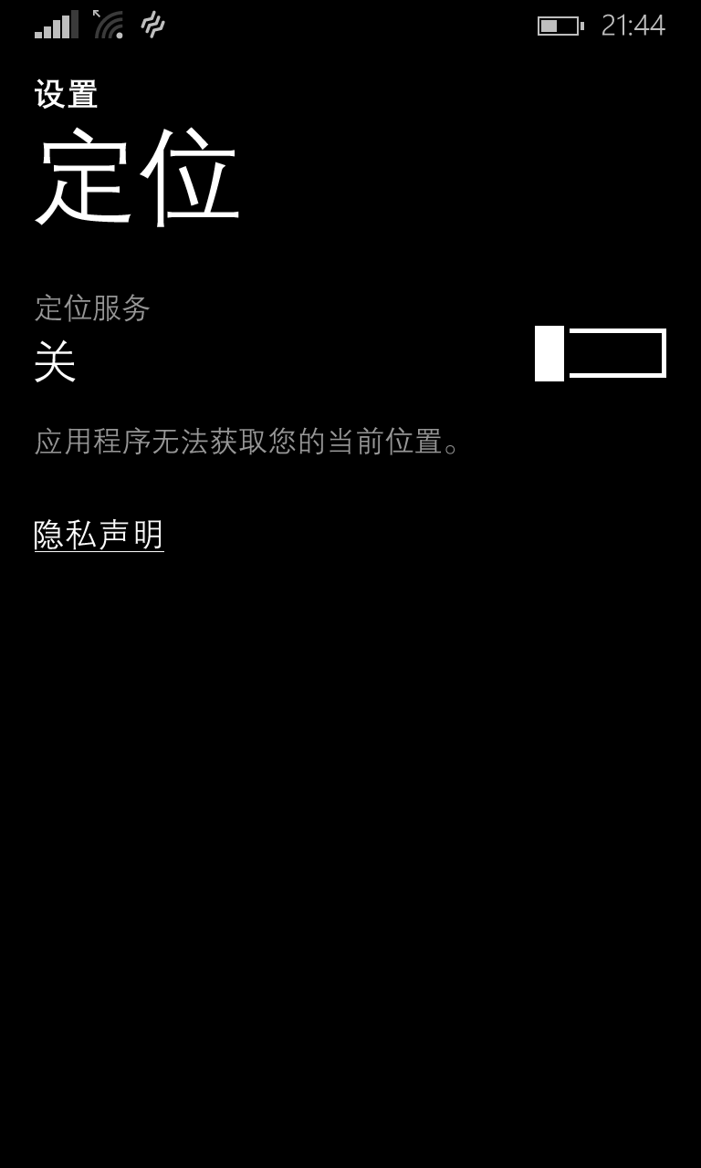
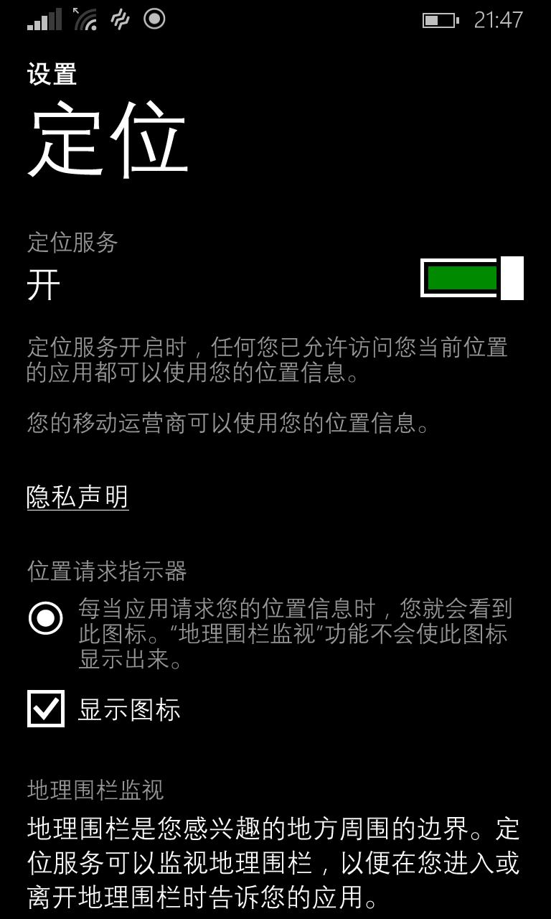
Please turn on the Location before using Smart horn. If you forgot it, Smart Horn will remind you with a message. (Wi-Fi or 4G network is not needed for the application.)

Slide 3
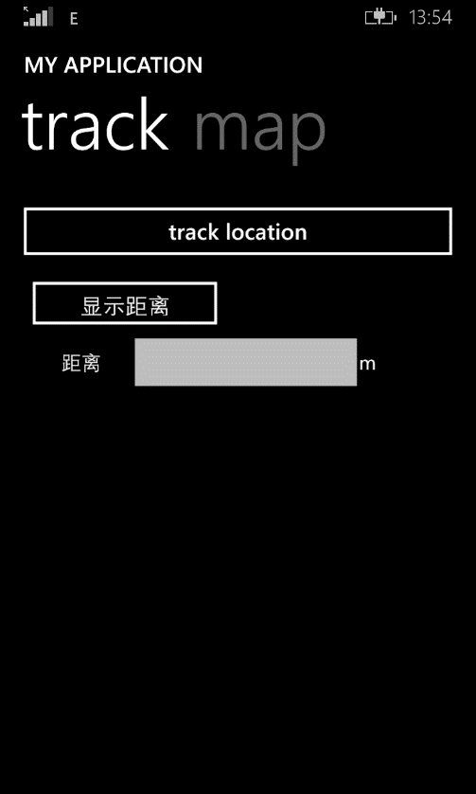
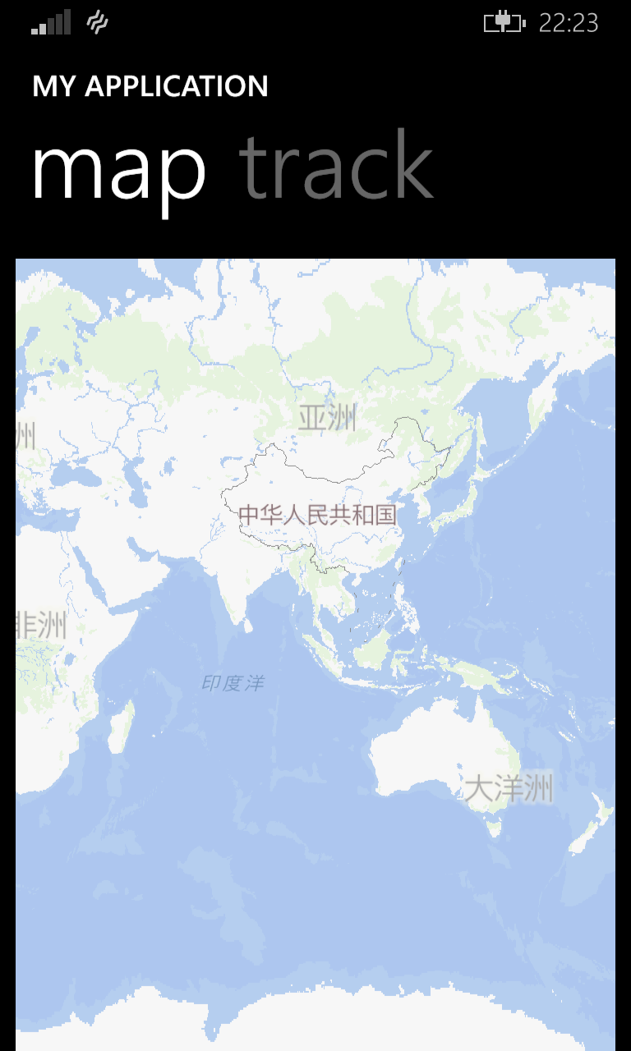
Below are the two main pages. Track and Map

Slide 4
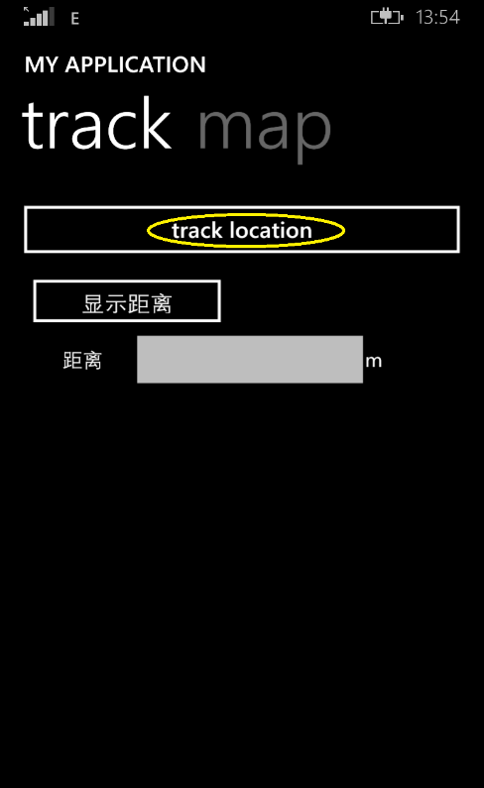
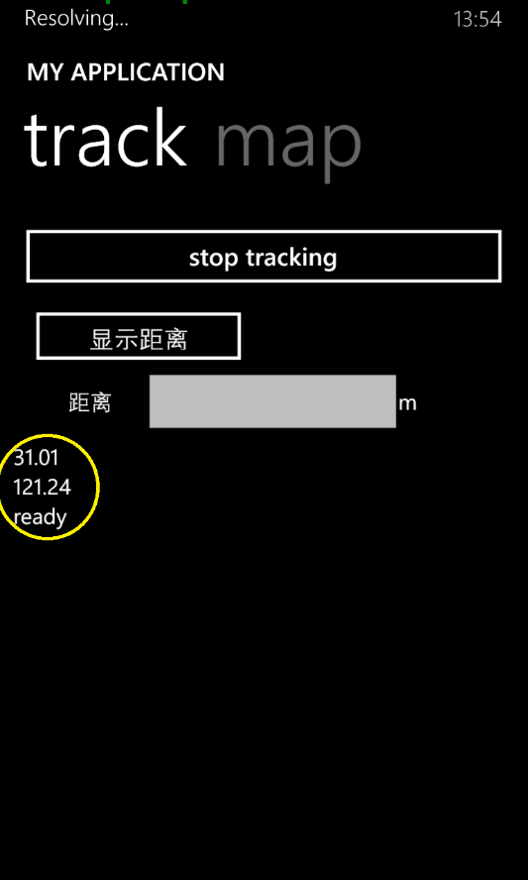
1. Press the button <<track location>>, if you see initializing and latitude and longitude of your location and ready, You have successfully initialized Smart Horn

Slide 5
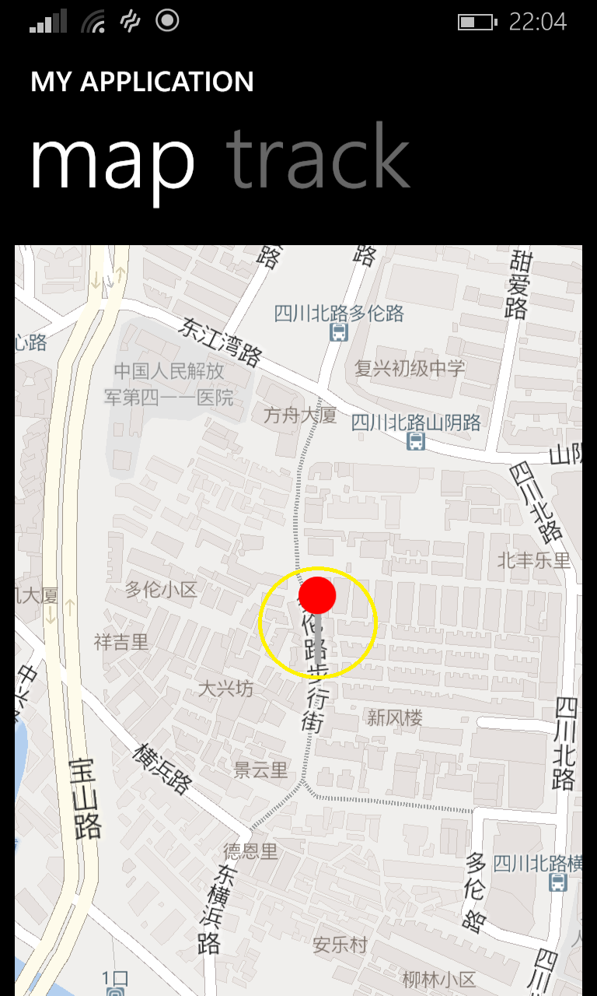
2. Then you will find a mark on the map page, it is your current location

Slide 6
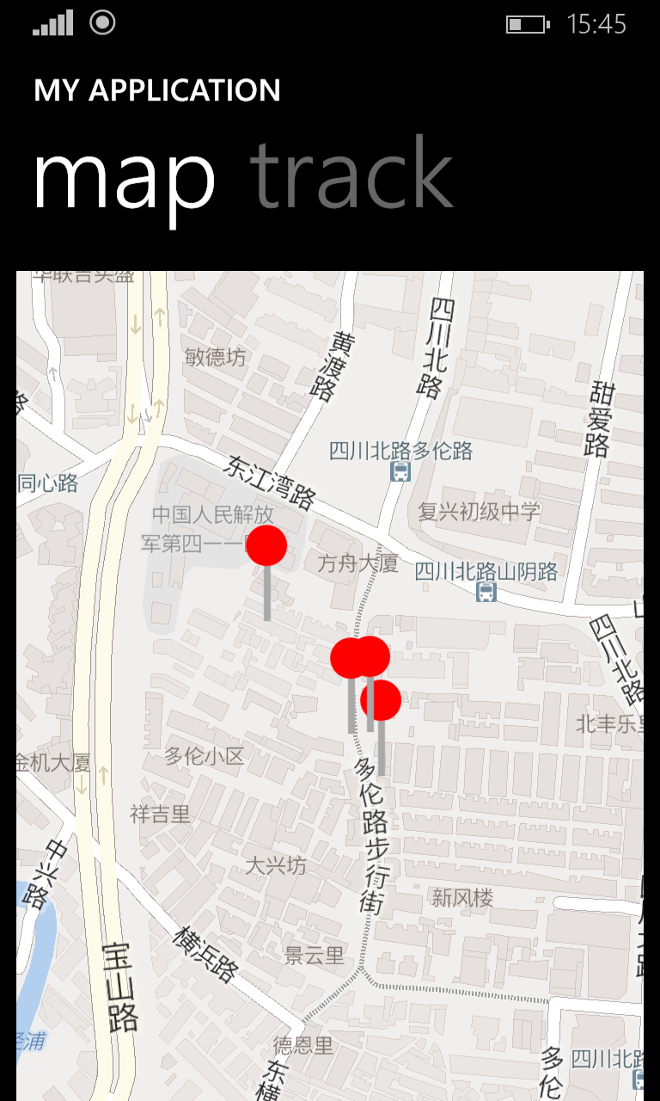
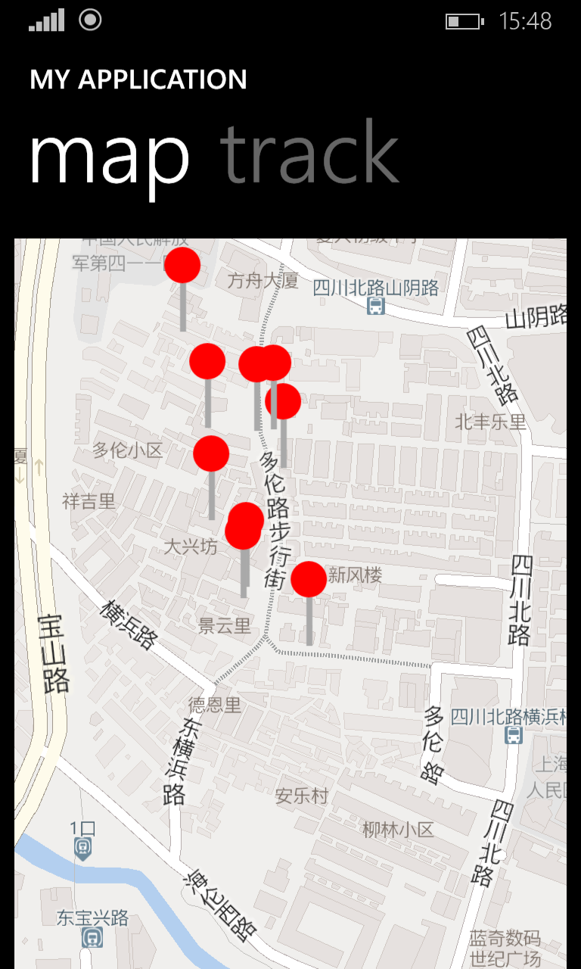
3.With the change of your position, the application will use a lot of mark to record your track of location

Slide 7
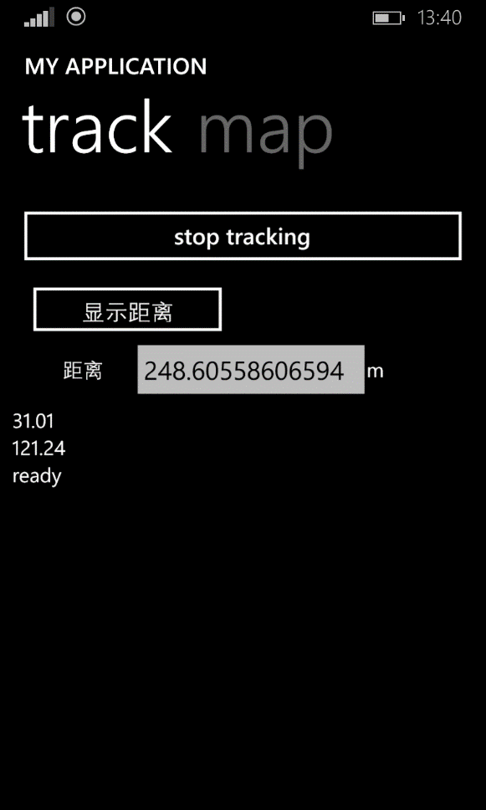
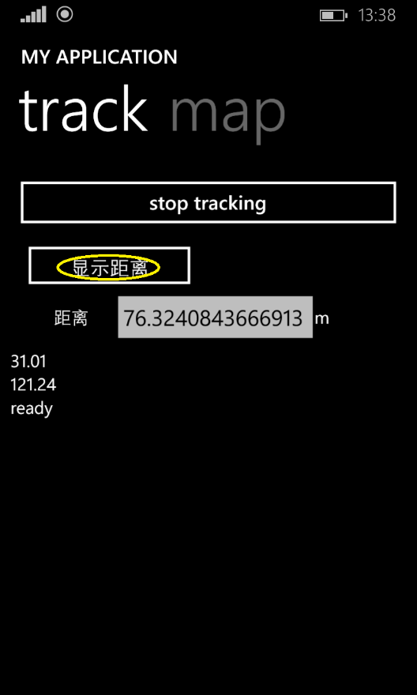
4.Press the <<显示距离>>button, the textbox will display your distance from the first initial button. With the movement the distance will automatically increased

Slide 8
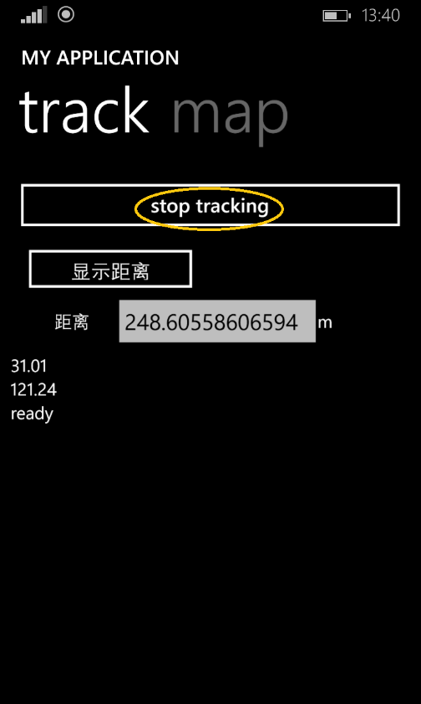
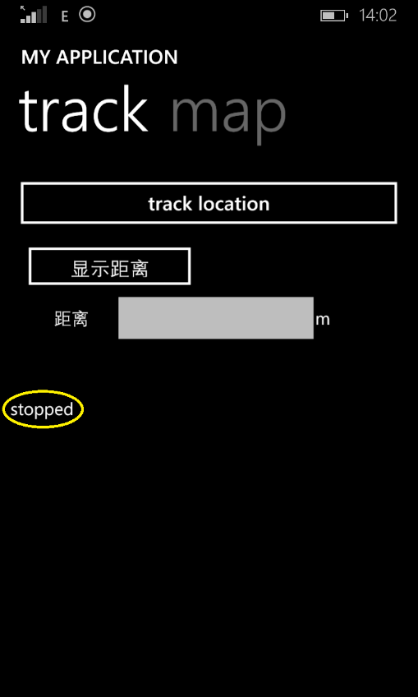
5. Press the <<stop tracking>> button, All the data will be cleared and you can restart it whenever you want.

Slide 9
Thank you
for watching

